Slide 1
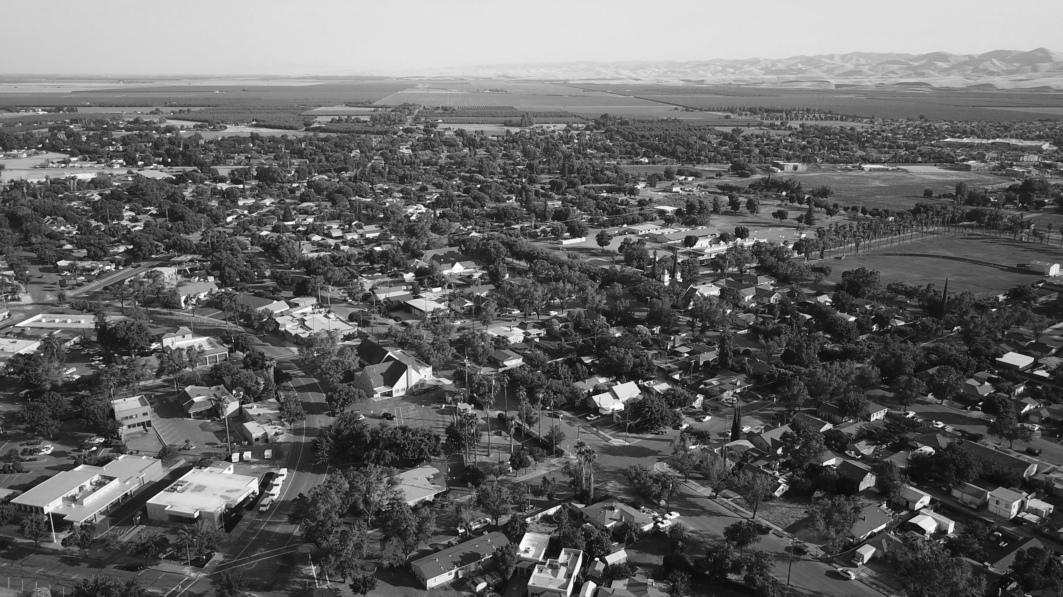

2025 Hexavalent Chromium (Cr6) regulation
June 3, 2025

Slide 2
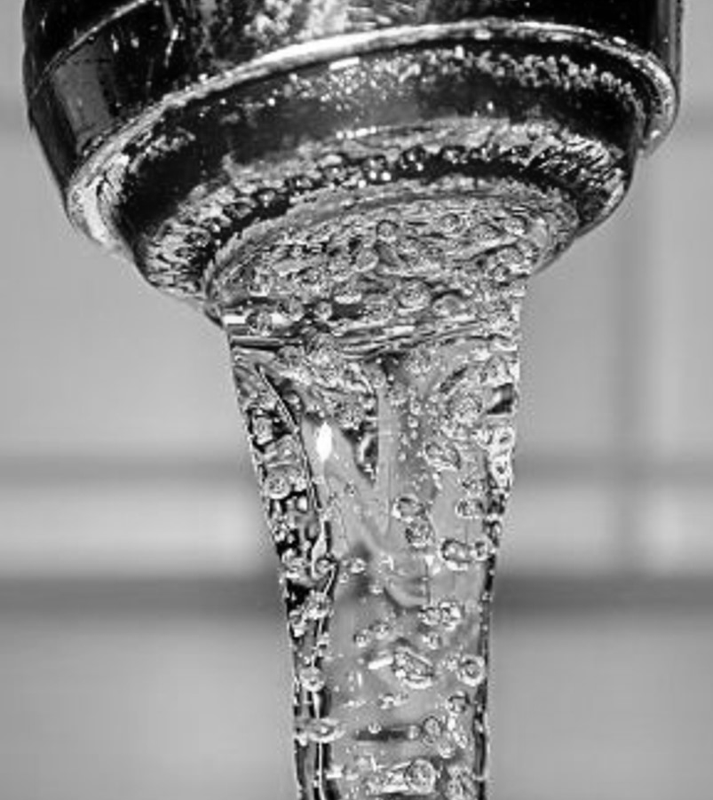
agenda
background
History on Cr6 MCL Setting process
Past actions regarding cr6
Requirements from Exceedance letter
Public notification process
components of Compliance action plan
Next steps

Slide 3

background
What is Chromium? Chromium is naturally found in rocks, plants, humans and animals.
Exists in two forms:
Chromium-3 is an essential human dietary element. It is found in many vegetables, fruits, meats, grains, and yeast.
Chromium-6 occurs naturally in the environment from the erosion of natural chromium deposits. It can also be produced by industrial processes.
Patterson has always had a small trace amount of chromium 6 that is naturally occurring and not caused by industrial contaminant.
Together, chromium 3 and chromium 6 make up Total Chromium. Federal standard for Total Chromium is 100 ppb; state standard is 50ppb.

Slide 4
History on Cr6 MCL Setting process
2014
In 2014, the State of California created a new maximum contaminant level, or MCL, for hexavalent chromium. The new MCL was adopted at 10 micro-grams per liter, or 10 parts per billion (ppb).
2015-2016
Over the next 18 months, the city developed a Corrective Action Plan (CAP) on how it was going to address Cr6.
A Feasibility Study was also developed identifying the Best Available Treatment (BAT) options for treating Cr6 and the cost associated with those treatments.
2017
In May 2017, the Superior Court of Sacramento County issued a judgment invalidating the new California MCL of 10 ppb for Cr6. The court determined Water Board failed to properly follow the requirements of the Safe Drinking Water Act for establishing the new MCL. MCL was rescinded.
2022-2024
The Water Board undertook a new rulemaking process and in 2022, the Board proposed a new Cr6 MCL. After a public comment period and further revisions, the revised Cr6 MCL regulation was adopted and went into effect in 2024. The reestablished MCL for Cr6 remains at 10 ppb.
2025
The SWRCB has issued a compliance directive following a confirmed exceedance of Well No. 07.
A compliance directive is expected for the remaining potable wells by September 2025.
Prior to the creation of the new Cr6 MCL, the city’s groundwater quality met all state and federal drinking water standards without any form of supplemental water treatment. This will no longer be the case.

Slide 5
Past actions regarding chromium 6
Following the 2014 adoption of the Chrome 6 MCL, the City initiated quarterly monitoring for Chrome 6 in their seven potable wells.
Submitted a Corrective Action Plan (CAP) outlining the steps and estimated timeframe needed to achieve Chrome 6 compliance.
Using the mitigation/treatment approach, the city completed the following steps:
Field testing of wells to determine the potential for Chrome 6 source control.
Feasibility study to evaluate and screen treatment and facility siting alternatives.
Pilot testing to develop/confirm site specific design criteria for the selected Chrome 6 treatment process.
The pilot project was successful in reducing the concentration levels for Cr6.

Slide 6
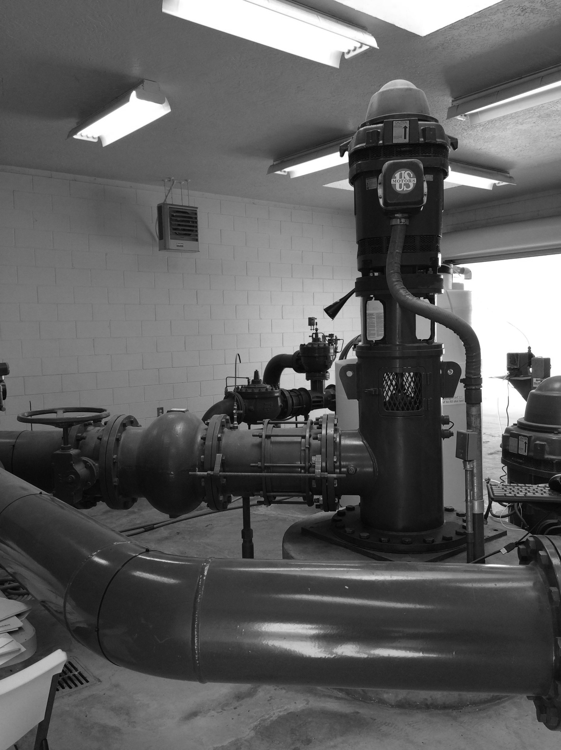
Past actions regarding chromium 6 (continued)
For years after, we continued to monitor the pilot-tested well site on a quarterly basis.
A feasibility study was prepared looking at both well head treatment and centralized treatment.
When the MCL was rescinded, the design and installation of a centralized facility or on-site treatment was placed on hold until the new MCL is established by the State.
The city can then identify which wells will require treatment, if any, and which treatment alternative will be able to meet the new standard.
In 2016, construction capital costs were estimated to be between $65 and $128MM to comply with the Cr6 MCL.

Slide 7
2025 Cr6 MCL Compliance Directive
Well No. 07

Slide 8
New Cr6 Exceedance
As a result of this regulatory update, the City resumed Cr6 monitoring in accordance with state requirements.
Based on the most recent sampling data between December 10, 2024 and March 4, 2025, Well No. 07 has exceeded the new Cr6 MCL.
Running average= 13 ppb Chromium 6 MCL= 10ppb
Although this compliance directive currently applies only to Well No. 07, it is anticipated that the remainder of the City’s potable wells will also exceed the Cr6 MCL when they are sampled again in August 2025.
Therefore, the DDW has recommended that the City’s compliance plan proactively address the likelihood of future exceedances at additional wells, even if they have not yet officially triggered compliance action.
Although the City had anticipated a compliance order would be issued in late 2025, the exceedance was confirmed earlier than expected, accelerating the City’s regulatory timeline.
The City is now required to send out quarterly notifications to the public and submit a Compliance Action Plan.

Slide 9
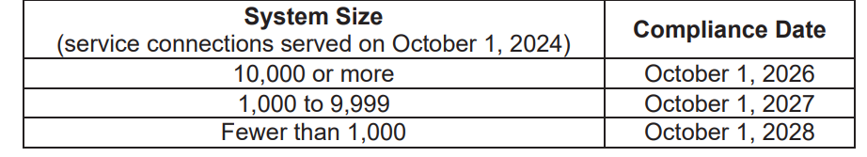
Requirement #1- Distribute Tier 2 Public Notification Due June 13, 2025
An exceedance of the hexavalent chromium maximum contaminant level (MCL) requires Tier 2 notification, and you must provide public notice to persons served as soon as practical but within 30 days after learning of the exceedance.
Such an exceedance is not considered a violation until after the applicable compliance date (see table below).

Slide 10
Notification methoDS
Primary Method
Mail or direct delivery. The notice must be distributed to each customer receiving a bill including those that provide their drinking water to others (for example schools or school systems, apartment building owners, or large private employers), and other service connections to which water is delivered by the water system.
Secondary Method
Publication in a local newspaper.
Posting in conspicuous public places served by the water system or on the internet. The notice must be posted in place for as long as the exceedance or occurrence continues, but in no case less than seven days.
Delivery to community organizations.

Slide 11

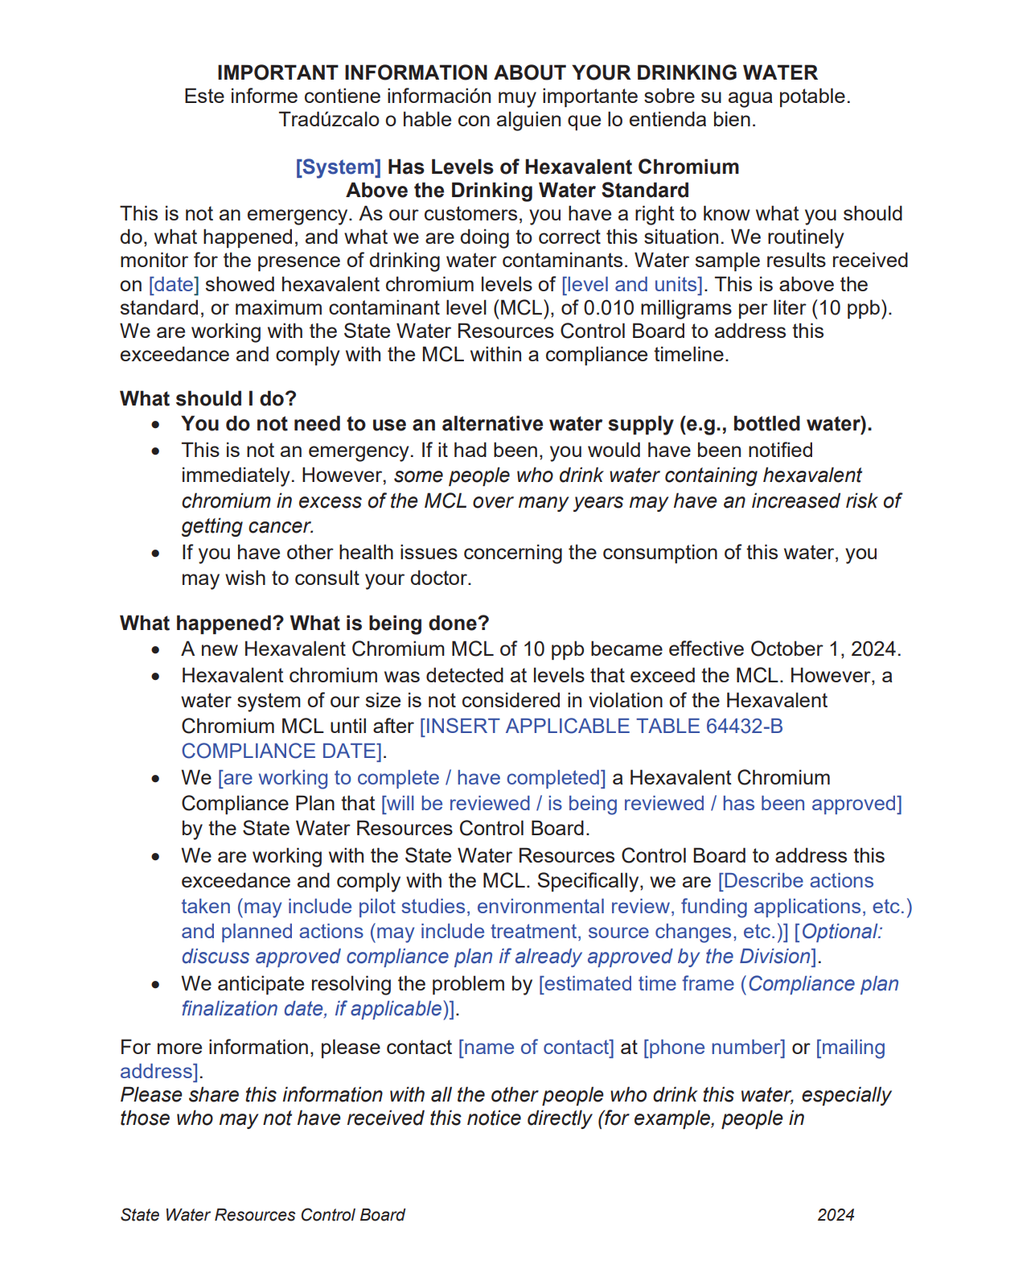
First notification will be included with June’s utility bill expected before June 13, 2025.

Slide 12
Compliance ACTION PLAN-Due June 30, 2025
The water system is also required to take specific actions described in the Cr6 regulation, the first step of which is to develop a compliance plan that includes the following items:
Field Testing of Wells
Feasibility Study
SGMA
GPCD Reductions
Pilot Testing
Basis of Design Report
Engineering Design
Environmental Documentation (CEQA)
Permitting
Funding/Financing
DWSRF
Water rates
Operations Plan
Construction
Commissioning/Acceptance
A draft Compliance Action Plan was submitted to the Division of Drinking Water on May 22, 2025.
Estimated Time for Compliance= 52 months

Slide 13

Next Steps
Presentation to City Council and Public on Compliance Directive- June 3, 2025
First Tier 2 Public Notification- NLT June 13, 2025
Will occur every quarter
Compliance Action Plan (CAP)- Due June 30, 2025
2024 Consumer Confidence Report- NLT July 1, 2025
Completion of Feasibility Study- Estimated September 2025

Slide 14
Questions?
Public Works Department
POC: Maria Encinas
(209) 895-8060
mencinas@pattersonca.gov
www.pattersonca.gov

