Slide 1

Urban Bicycle Trail Project at Salado Creek
City of Patterson
March 24, 2021

Slide 2
City Contact Information
Tiffany Rodriguez
Capital Projects Manager
Phone: (209) 895-8075
Email: tirodriguez@ci.Patterson.ca.us

Slide 3
Previous Community Presentation Talking Points
Review Project Details
Discuss Project Timelines
Address possible concerns
Future of the Trail: potential bicycle parking locations, sponsorship of benches, bicycle education campaign

Slide 4
Overview of Current Community Presentation
Review Project Plans and Bike Trail Layout
Discuss Updated Project Timelines
Address Possible Concerns from previous presentations

Slide 5
Project Details
The City was awarded $1,808,145.00 through the Urban Greening Grant for this project
Plant 273 new native trees
Construct 6,458 linear feet of connected bike & pedestrian path with path lighting

Slide 6
Project Details
Creates connectivity with the existing City bicycle & pedestrian paths
Creates a protected undercrossing at American Eagle Avenue and Sperry Avenue
Connects Apricot Valley Elementary, Creekside Middle School and 3 public parks

Slide 7
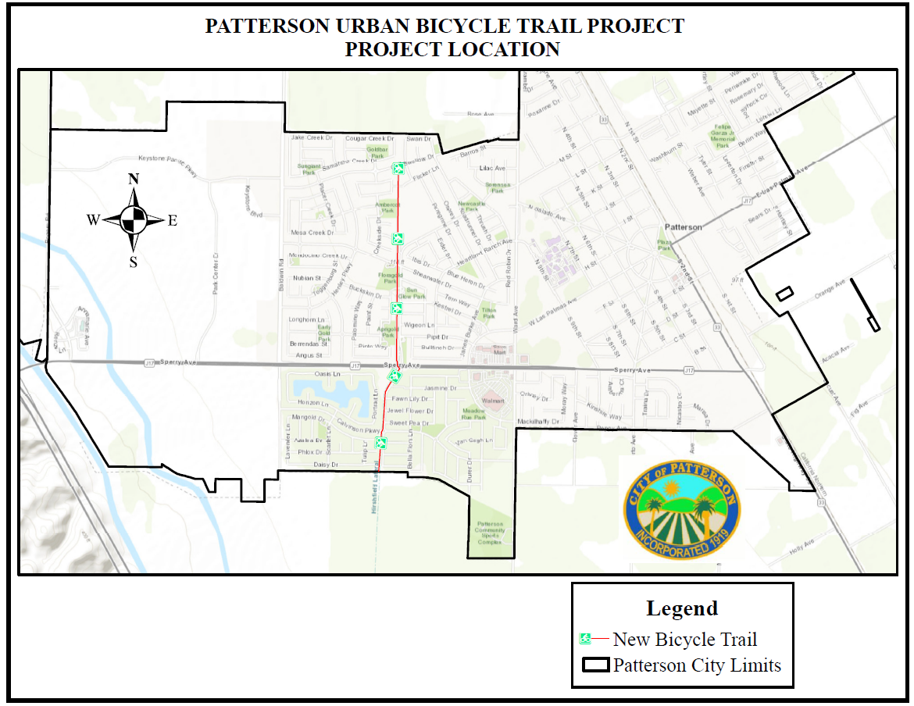

Slide 8
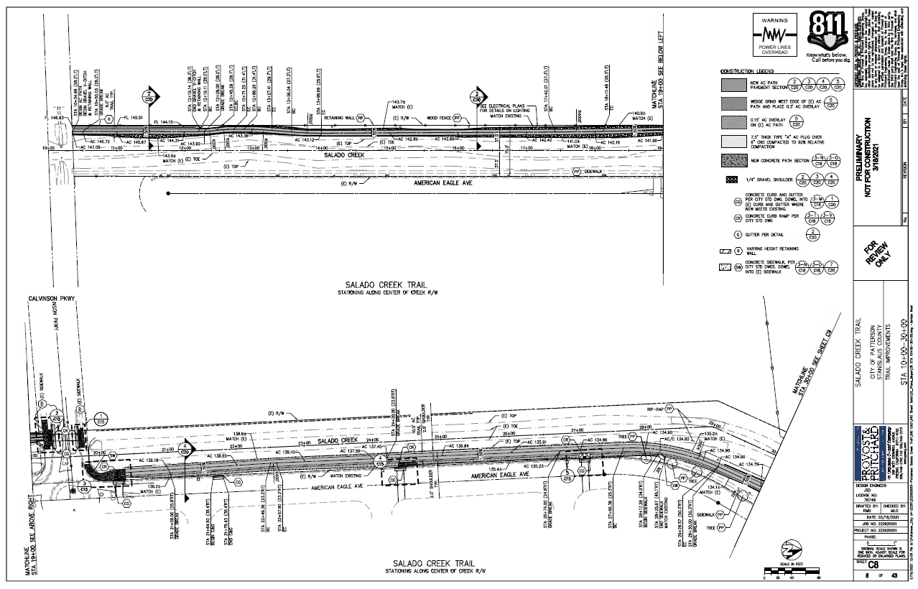

Slide 9
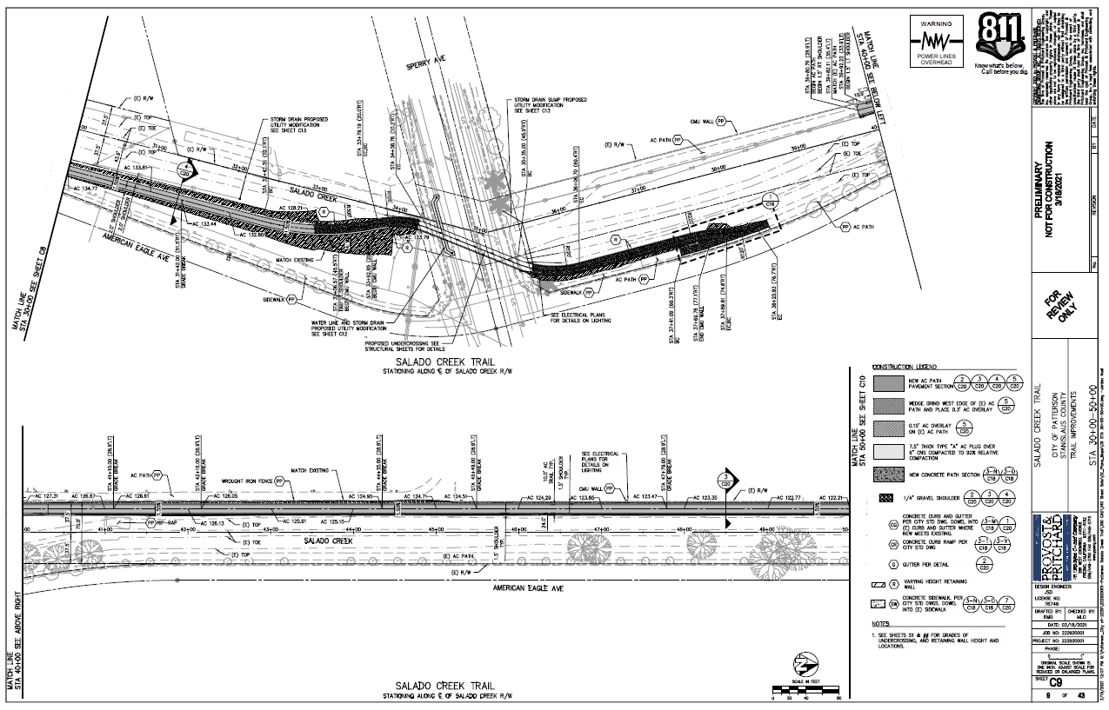

Slide 10
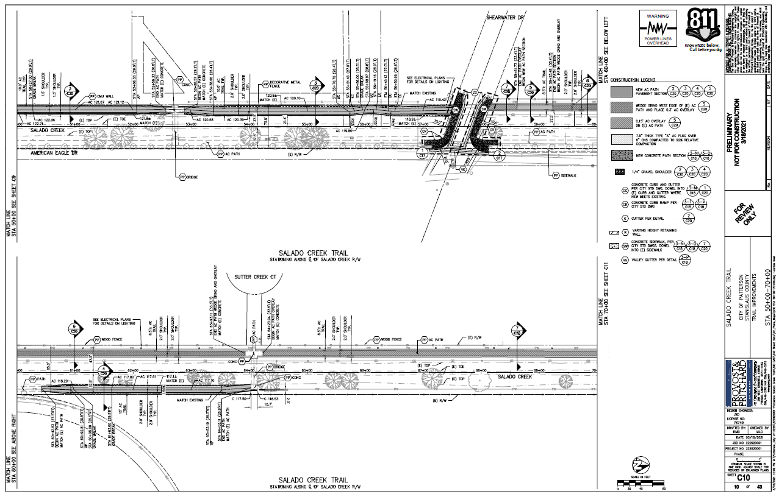

Slide 11
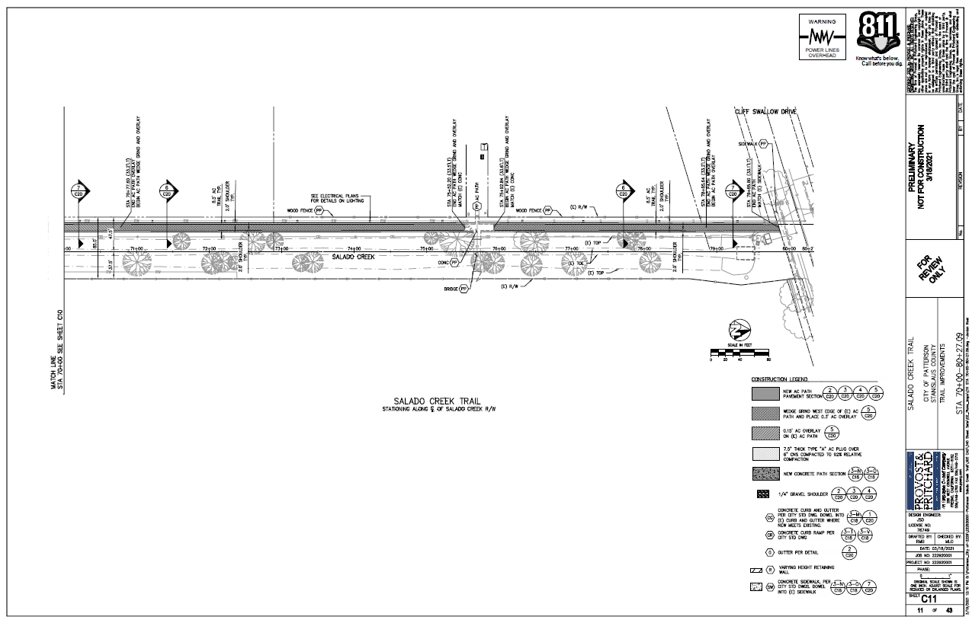



Parks
Schools
Patterson Sports Complex

Slide 12
Updated Project Milestones
Environmental Clearance: Complete January 2021
Final Engineering Plans: Complete April 2021
Advertise for Construction: April 2021
Start Construction: June 2021
Complete Construction: November 2021

Slide 13
Potential Concerns Discussed Previously
Trees being Planted with this project
Lights along the Trail
Noise During Construction
Maintaining Safety Along the Trail

Slide 14
Potential Concerns Discussed Previously Continued
Bench and trash can locations
Centerline along the path
Access to the trail

Slide 15
Trees Planted with this Project
  Tree selection for the project was a joint effort between the Parks and Urban Forestry Division. Selections were based on the attributes below:
  Water needs (all tree selections are low or moderate). Approved for this hydro region.
  Tree stature such as height and spread and spacing
  Known history with trees and required maintenance

Slide 16
Lights Along the Trail
Lights will be hooded and directed away from nearby residential neighborhoods
Compliance with California Building Code, Title 24, California Code of Regulations, will ensure that light and glare impacts from the proposed project will not have a significant impact to residents.

Slide 17
Noise During Construction
Construction activities shall be restricted to the hours of 7:00 a.m. to 6:00 p.m., Monday through Friday.
Construction work on Saturday will only be permitted for extenuating circumstances with the approval of the City Engineer.
No construction will take place on Sundays or federal and state holidays

Slide 18
Noise During Construction
A “construction liaison” shall be designated to ensure coordination between construction staff and neighbors. Occupants and property owners of residences within 400 feet of construction activity shall be notified in writing of the construction schedule and the contact information for the construction liaison.

Slide 19
Maintaining Safety Along the Trail
Lights will be placed along the trail to maintain a well light area
Lights will be placed in the undercrossing as well
The trail is rated for vehicular traffic as necessary. Maintenance or emergency vehicles will have access.

Slide 20
Bench and trash can locations
Benches and trash cans will be placed along the trail
The City will evaluate the best locations after construction is complete.
Community input will be sought as well
The City will look at options for sponsored benches.

Slide 21
Centerline along Bike Trail
Yellow Centerline Stripe will be placed through the tunnel and along the approaches to the tunnel
Manual on Uniform Traffic Control Devices States a centerline is beneficial when:
  There is heavy Traffic
  On curves with restricted sight distance
  Where the path is unlighted

Slide 22
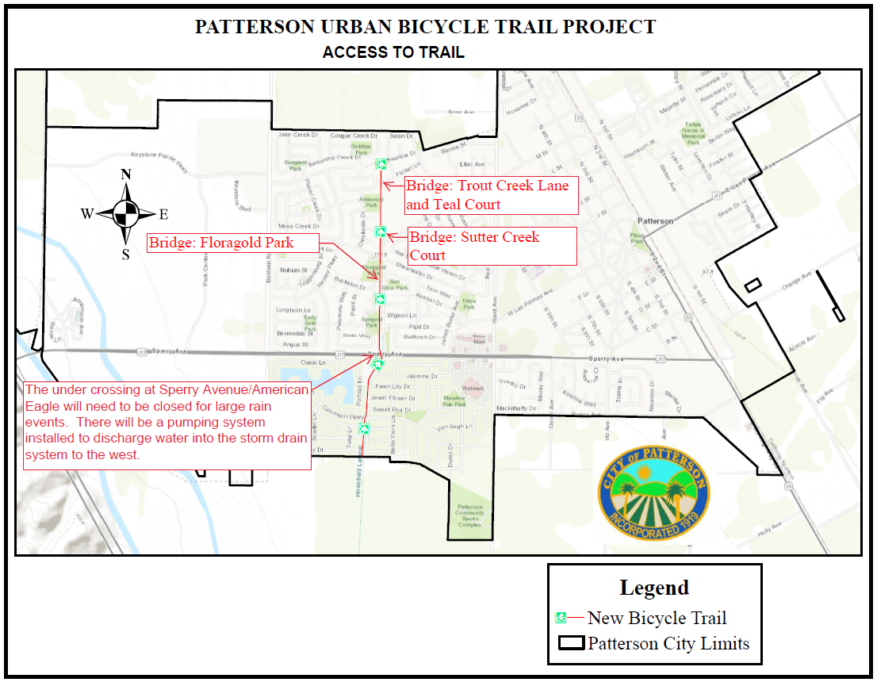
Notes:
Currently no plans to add additional bridges along Salado Creek.

Slide 23
Questions?
Comments?
Please let us know
Tiffany Rodriguez
Capital Projects Manager
Phone: (209) 895-8075
Email: tirodriguez@ci.Patterson.ca.us

